Slide 1
SPS Summer 2011 Summary
Matt Hollingsworth

Slide 2
Setup
Trigger: Fast-OR
Zurich Telescope
PLT
ROCs @ 20 deg
Used 3 plane telescope + optoboard with backwards ALT chips
Trigger created from scope probe and NIM logic (not from FED coincidence trigger)
Trigger was sent to TTCci, retransmitted to trigger Zurich telescope, and two data streams were synced with FED trigger counter <-> scaler in Zurich Telescope VME crate
Same Fiber and Power Supply used as was used for casette
Goals: Measure Lorentz Drift and spatial resolution—extension of last year’s program with less multiple scattering

Slide 3
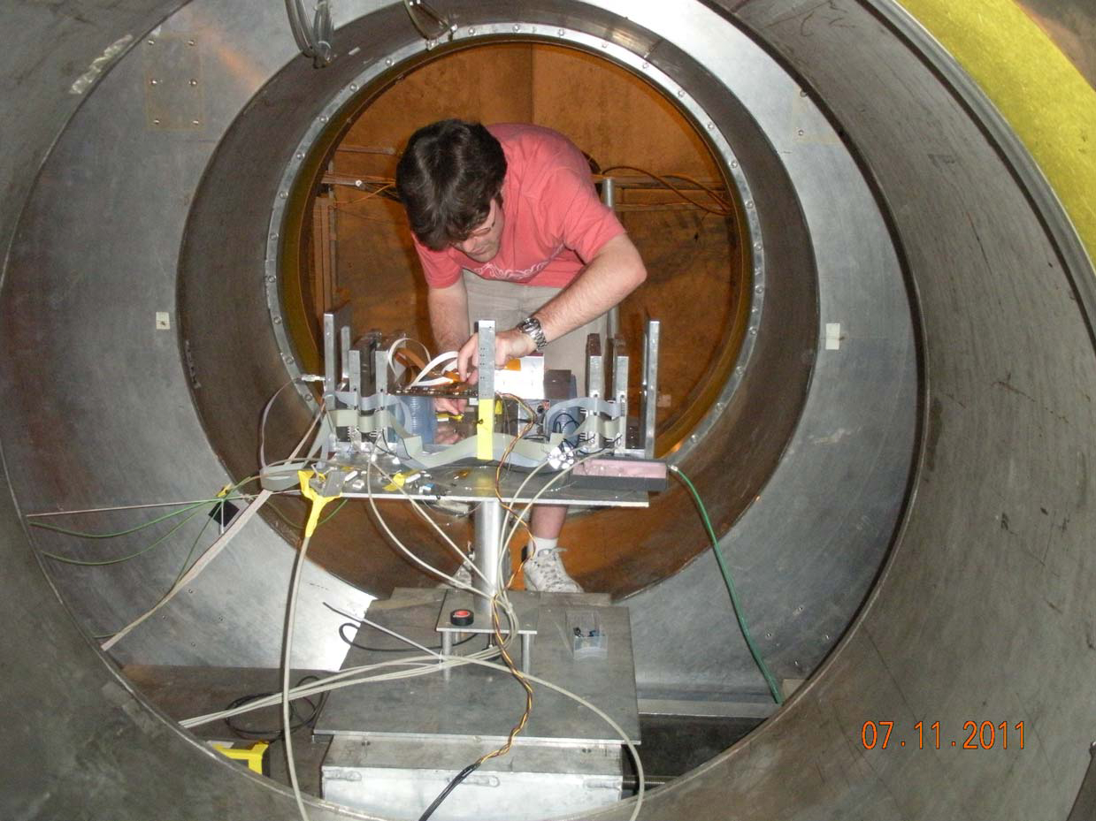
Full Assembly inside Magnet

Slide 4
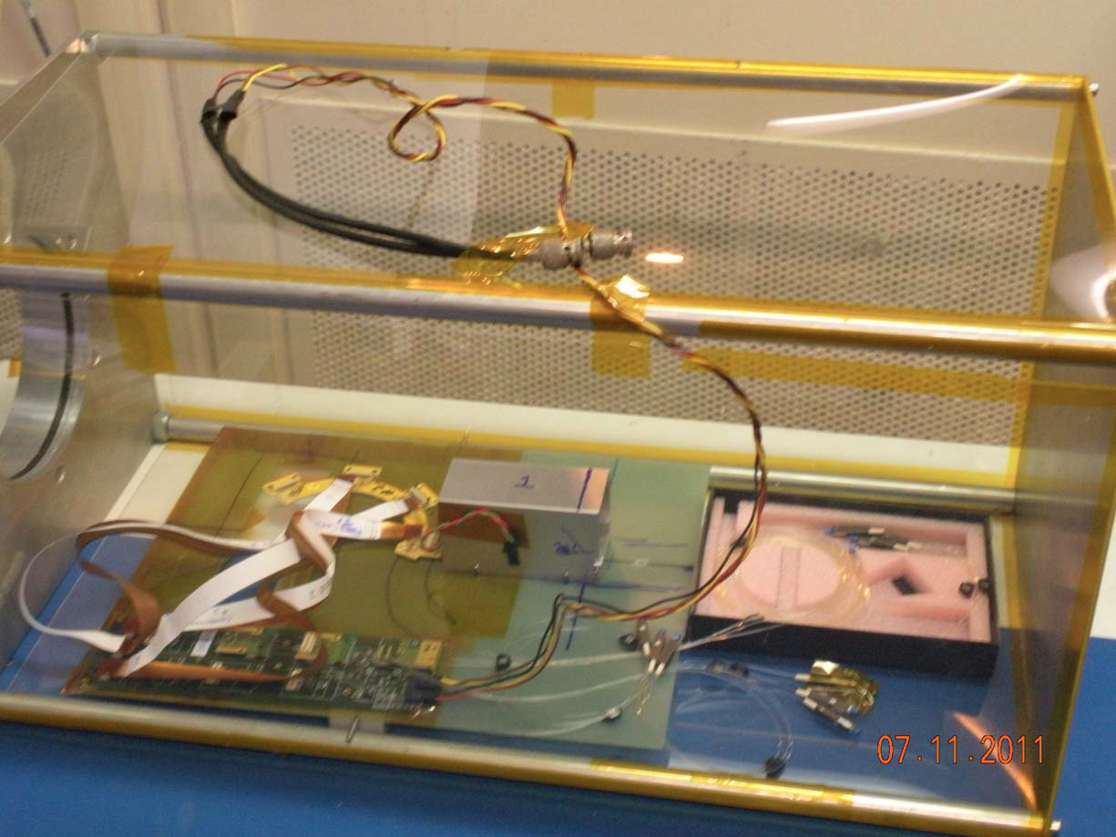
Telescope Assembly

Slide 5
B-Field Direction
ROC
Drift
E
B
X
Row
Beam
Magnetic field is in barrel configuration, B-field parallel to the floor
Drift is in the row direction

Slide 6
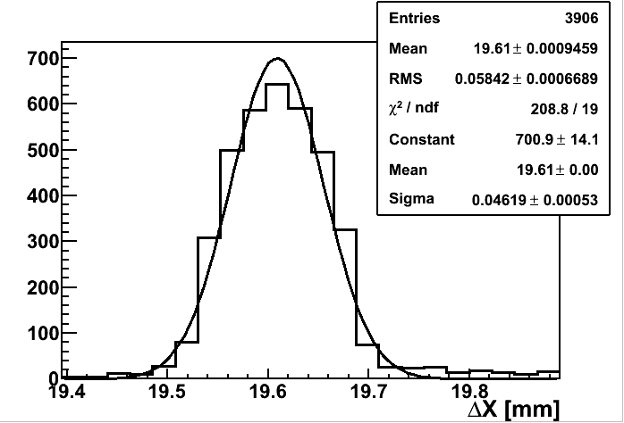
Run Summary
B Field | # Events | Good Track in Strips ( >= )
+3 Tesla | 94941 | 22950
-3 Tesla | 70199 | 15632
Other B (+2, -2 +1) | 133332 | 36389
0 Tesla | 64361 | 25829
Total | 362833 | 99973
Runs above have been checked for data quality
Analysis just beginning, but preliminary checks imply consistency ->
(No quality cuts yet performed, no gain calibration included, no alignment… very preliminary)

